Slide 1

Web scraping to gain company insights
5th April 2023 Viswanatha Sharma Chepuri, MSc, Data Scientist

Slide 2
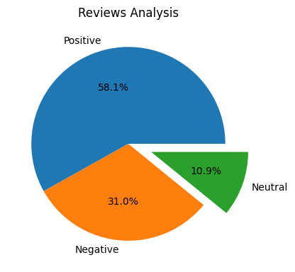
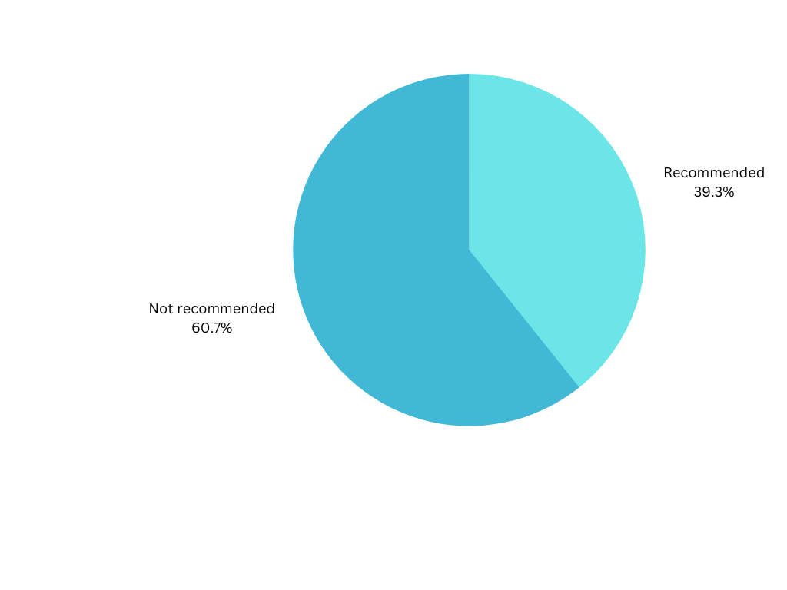
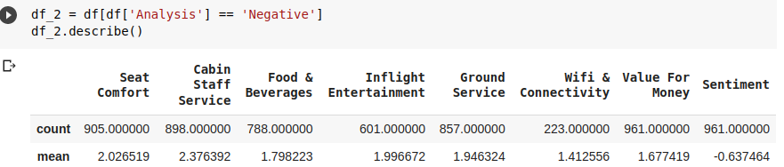
Analysis of consumers satisfaction
The customers who gave positive feedback have not gave there decision for recommendation.
Possible Reason effecting the experience to customers:
1) The wifi & connectivity is not up to the mark. That can solved with regular maintenance and troubleshooting the network errors.
2) Business class has very negative feedback on food and not feel value for their money, similar with economy class.
3)Inflight entertainment need to be updated and implement better recommendation systems rather than collaborative filtering. As, the customers are from different regions, the content can not relevant.
has

